Slide 1

Implementation CoAP module for IoTApi (IOT1.12)
Software Engineering
Prof. Dr. Andreas Pech
Mr. Damir Dobric
Presented By:
Hien Pham The – 1067411

Slide 2
Agenda
CoAP Protocol Introduction
Protocol Stack
Message Format
Request Method
Response Method
Message Type
Request/Response Matching
CoAP Client Connector Implementation
Unit Test
Conclusion

Slide 3
Agenda
CoAP Protocol Introduction
Protocol Stack
Message Format
Request Method
Response Method
Message Type
Request/Response Matching
CoAP Client Connector Implementation
Unit Test
Conclusion

Slide 4
CoAP: Constrained Application Protocol
a specialized web transfer protocol for use with constrained nodes and constrained networks.
limited power supply,
manufacturing costs,
RAM, ROM
generally low processing capabilities
uses a compact binary format and runs over UDP as transportation
designed for machine-to-machine (M2M) applications
smart energy
building automation
is network-oriented protocol, using similar features to HTTP but also allows for low overhead, multicast, etc.

Slide 5
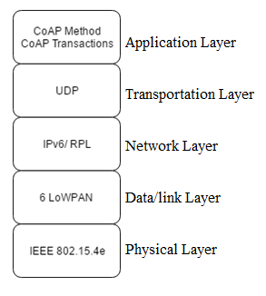
Physical layer:802.15.4e
Data link layer: 6LoWPAN is an acronym of IPv6 over Low Power Wireless Personal Area Networks
Transportation Layer: instead of using complex congestion control as in TCP. CoAP use UDP. UDP:
- unreliable transport
- no acknowledgment of sent datagrams
- 8 octet (8 bytes) header field
- It is up to higher layer protocols to detect this datagram loss and initiate a retransmission
Application Layer: two-layer structure: methods and transactions
- transaction: duplicate detection and reliable delivery of messages
- enables RESTful interaction through the well-known methods GET, PUT, POST, and DELETE as well as response codes
Example of a CoAP protocol stack

Slide 6
Request Method Names | Descriptions
GET | Retrieves a representation for the information that currently corresponds to the resource identified by the request URI.
POST | Process the representation enclosed in the request.
PUT | Update or create the resource identified by the request URI with the enclosed representation.
DELETE | Delete the resource identified by the request URI.

Slide 7
Type 2xx: Success: indicates that the clients request was successfully received, understood, and accepted.
2.01 | Created | 2.02 | Deleted
2.03 | Valid | 2.04 | Changed
2.05 | Content
Type 4xx: Client error: intended for cases in which the client seems to have errored.
4.00 | Bad Request | 4.01 | Unauthorized
4.02 | Bad Option | 4.03 | Forbidden
4.04 | Not found | 4.05 | Method not allowed
4.06 | Not acceptable | 4.12 | Precondition Failed
4.13 | Request Entity too large | 4.15 | Unsupported Content-Format
Type 5xx: Server Error: indicates cases in which the server is aware that it has erred or is incapable of performing the request.
5.00 | Server internal error | 5.01 | Not implemented
5.02 | Bad Gateway | 5.03 | Service unavailable
5.04 | Server Timeout | 5.05 | Proxying not supported

Slide 8
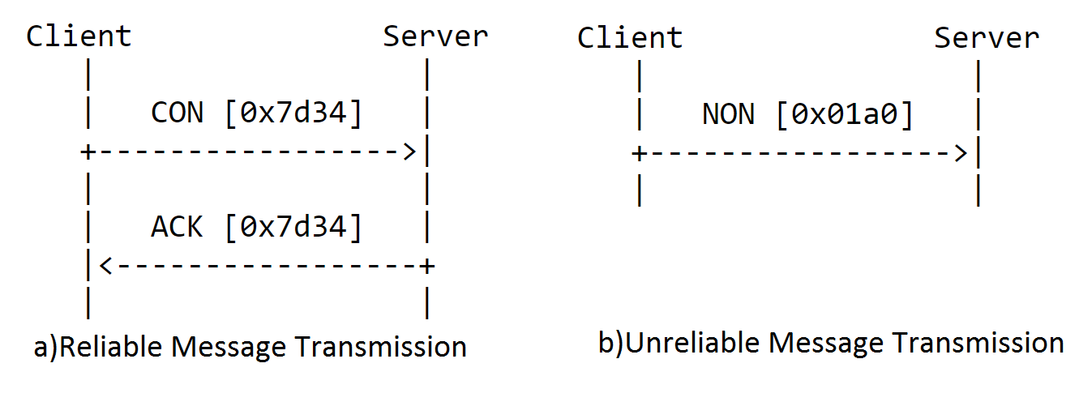
Confirmable (CON): requires receiving peers to send back an acknowledgement or reset messages
Acknowledgement (ACK): indicating received message
Non-confirmable (NON): message does not require answer messages sent by the receiver
Reset (RST): When a recipient is not at all able to process a Confirmable message, it replies with a Reset message instead of an Acknowledgement.

Slide 9
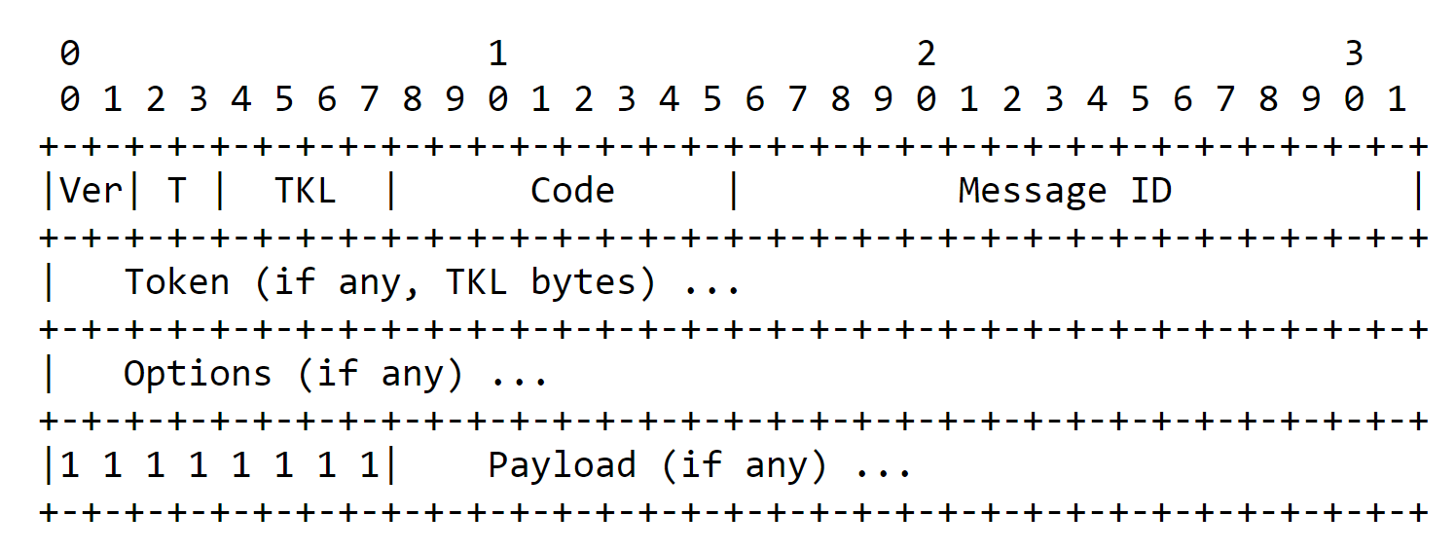
Ver (Version): indicates the CoAP version number
T (Type): message Type
TKL (Token length): indicates number of token bytes after this header
Code: indicates the message request method (1-10) or response code (40-255)
Message ID: detects message duplication, and matches response

Slide 10
Request/Response Matching
There are two headers namely token and message ID, are used to be as reference for matching request and response
The source endpoint of the response must be the same as the destination endpoint of the original request
the Message ID of the Confirmable request and the Acknowledgement must match, and the tokens of the response and original request must match.

Slide 11
Agenda
CoAP Protocol Introduction
Protocol Stack
Message Format
Request Method
Response Method
Message Type
Request/Response Matching
CoAP Client Connector Implementation
Unit Test
Conclusion

Slide 12

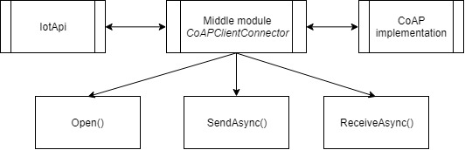

Slide 13
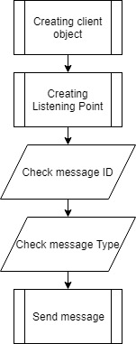
Send asynchronous

Slide 14
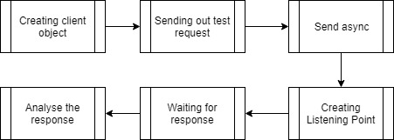
Receiving Asynchronous

Slide 15
Agenda
CoAP Protocol Introduction
Protocol Stack
Message Format
Request Method
Response Method
Message Type
Request/Response Matching
CoAP Client Connector Implementation
Unit Test
Conclusion

Slide 16
Testing the sending asynchronous functionality:
Test client request delete
Test client request get
Test client request put
Test client request post
Testing receiving asynchronous functionality
Test client response get

Slide 17
Agenda
CoAP Protocol Introduction
Protocol Stack
Message Format
Request Method
Response Method
Message Type
Request/Response Matching
CoAP Client Connector Implementation
Unit Test
Conclusion

Slide 18
Conclusion
What I learnt:
The future of IoT Api
Working with C# and .NET core
Based on theoretical background, asynchronous sending and receiving module is generated. The projects also include some unit test to validate the ability of interacting between the given IotApi and the CoAp Protocol.

